Slide 1


Encrypted File Storage App
Secure Your Files with AES Encryption

Slide 2



Project Overview
Robust Security
Secure Storage
Easy Retrieval
Utilizes industry-standard AES encryption for maximum data protection.
Encrypts and securely stores sensitive files locally.
Seamless decryption and retrieval with a master password.
The Encrypted File Storage App is designed to provide individuals and small teams with a simple yet powerful solution for safeguarding their digital assets.

Slide 3

The Problem: Data Vulnerability
In an increasingly digital world, sensitive personal and professional data is constantly at risk. Unauthorized access, cyberattacks, and accidental exposure can lead to significant financial, reputational, and privacy damages.
Traditional file storage often lacks the necessary encryption layers to protect against sophisticated threats, leaving users exposed.
"Data breaches are becoming more frequent and severe, highlighting the urgent need for robust personal encryption solutions."

Slide 4
Our Solution: Fortified Protection
AES Encryption Core
Offline Storage
Implements Advanced Encryption Standard (AES) with 256-bit keys, ensuring military-grade security for all stored files.
Files are encrypted and stored locally on your device, eliminating cloud-related vulnerabilities and dependencies.
Master Password System
Secure Operations
A single, strong master password controls access to all encrypted data, protected by robust key derivation functions.
Includes secure file deletion and key management to prevent data remnants and unauthorized recovery.

Slide 5

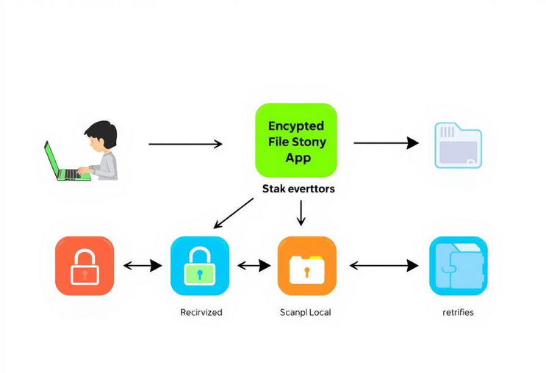
System Architecture
The architecture ensures a logical flow of operations, from user input to secure storage and retrieval, with clear separation of encryption and key management processes.

Slide 6
Key Features
Encrypt Files
Securely encrypt any file type using strong AES-256 encryption. The intuitive interface makes it easy to select individual files or entire folders for protection, ensuring all your sensitive data is safeguarded with military-grade standards.
Decrypt Files
Effortlessly restore your original files to their unencrypted state whenever needed. Our fast and reliable decryption process ensures quick access to your data, allowing for seamless workflow integration without compromising security or data integrity.
List Encrypted Files
Efficiently manage and view all your encrypted files stored within the secure vault. The application provides a clear, organized overview, enabling you to easily locate, categorize, and interact with your protected data. Comprehensive search and filter functionalities are also included for larger collections.
Change Master Password
Maintain robust security by easily updating your master password whenever necessary. The process incorporates strong key derivation functions (PBKDF2) to ensure that your new credentials are securely established and protect access to all your encrypted information.
Secure Delete
Permanently and irreversibly remove sensitive data from your device, ensuring it cannot be recovered by forensic methods. This feature employs advanced wiping techniques to safeguard your privacy and prevent any data remnants from lingering.
Offline Mode
Enjoy full functionality and access to your encrypted files even without an internet connection. All encryption, decryption, and file management operations are performed locally on your device, enhancing security and ensuring availability at all times.
File Organization
Organize your encrypted files within the application using a familiar folder structure. Create, move, and rename directories to keep your protected data neat and easily accessible, mirroring your unencrypted file management habits.
User-Friendly Interface
Designed with simplicity in mind, the application features an intuitive and clean interface that makes strong encryption accessible to everyone, regardless of technical expertise. Secure file management has never been easier.
These core features combine to create a comprehensive, highly secure, and exceptionally user-friendly file security application. Our commitment is to provide a robust defense against data vulnerabilities while maintaining ease of use for all individuals and small teams.

Slide 7




Technology Stack
Java
AES Encryption
Core programming language, ensuring cross-platform compatibility and robust performance.
Advanced Encryption Standard for strong cryptographic security.
PBKDF2
File I/O
Password-Based Key Derivation Function 2 for secure key generation from master password.
Java's built-in capabilities for efficient and reliable file handling.
Leveraging these proven technologies ensures the app's reliability, security, and scalability.

Slide 8

Benefits & Future Scope
Benefits of the App:
Enhanced data privacy and security for individuals.
Simple, intuitive command-line interface.
Robust protection against common digital threats.
Future Enhancements:
Graphical User Interface (GUI): Develop a user-friendly GUI for broader accessibility.
Cloud Integration: Securely integrate with cloud storage providers (e.g., Google Drive, Dropbox) with end-to-end encryption.
Multi-User Support: Implement features for shared secure vaults and granular access control.
Cross-Platform Deployment: Explore packaging for other operating systems beyond JVM.
The Encrypted File Storage App lays a strong foundation for personal data security, with ample opportunities for future growth and advanced features.

Slide 9


Thank You!
Your time and attention are greatly appreciated. We hope this presentation has provided a clear insight into the capabilities and potential of the Encrypted File Storage App.

